Slide 1
WELCOME TO ATMS 517!

Slide 2
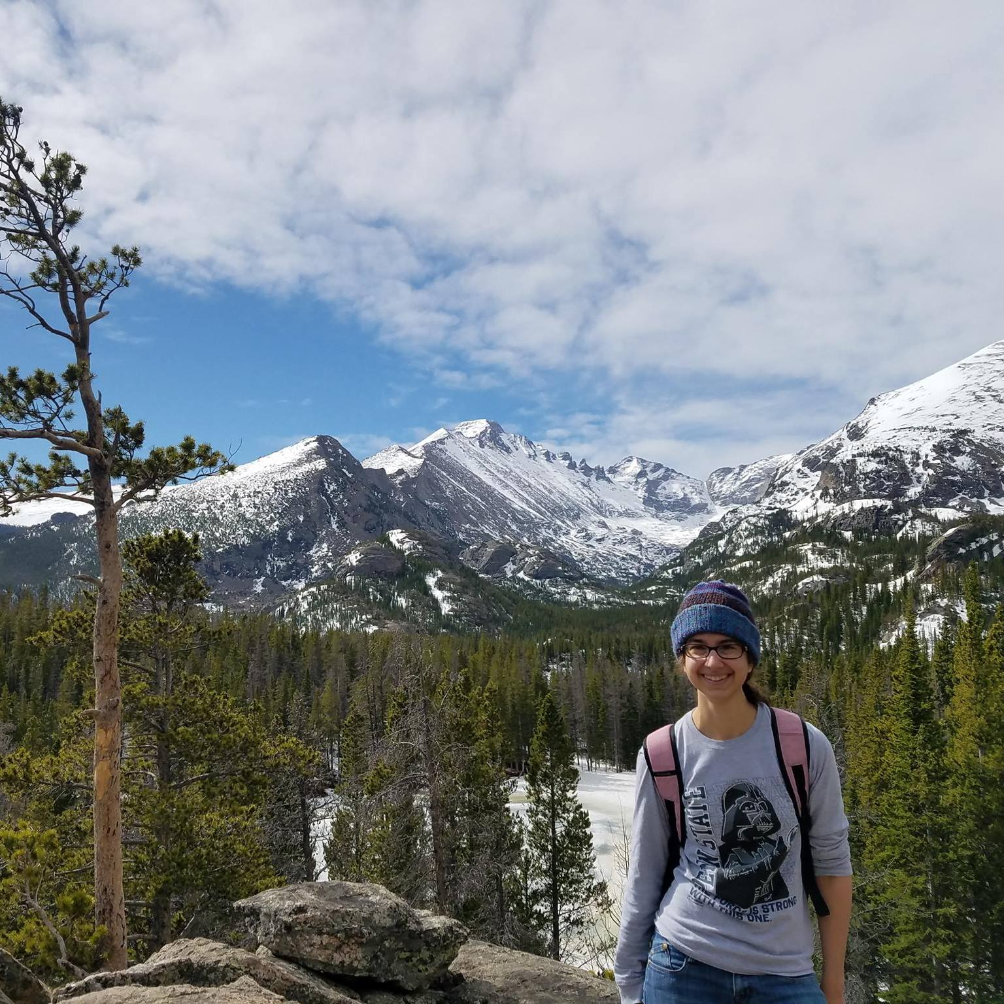
WHO AM I?
Position: Teaching Assistant Professor in Atmospheric Sciences
Where I’m from: Penn State (PA native!)
Research: modeling of supercell thunderstorms
What sparks joy? Nature & music!

Slide 3
WHO ARE YOU?
Name
Field
1-sentence research/work interests
What is one thing that brings you joy?
Please see + interact with icebreakers on Orientation Module later for more details!

Slide 4
GOALS OF THIS CLASS
Learn how to process, analyze, and visualize cool data using Python, beginning from the very beginning
Data science/statistical tools!
Take a new tool and learn how to use it effectively
Assumptions, advantages/disadvantages, uncertainty, applications, underlying principles
TL;DR, the why and how of working with geoscience data in careful and deliberate ways using Python tools

Slide 5
WHAT MIGHT YOU GET OUT OF THIS CLASS?
Some common feedback from students in the past two semesters:
Students who had minimal prior programming experience
Particularly valued learning all things Python
Students who had some experience in Python, but perhaps self-taught
Particularly valued learning and practicing Python tools and principles in a formal and rigorous manner, and refining their existing skills
Students who had lots of experience in Python
Particularly valued the data science/statistical aspects of this course, and the geoscience applications

Slide 6
COURSE SCHEDULE
Course Schedule
Fast-paced (but can adjust)
Each week is mixture of how to code stuff in Python + data science/statistical tools and concepts
Please talk to me if you haven’t programmed much before and have concerns!

Slide 7
STRUCTURE OF THIS CLASS
Please read the syllabus!!
“Lessons”: short, streamlined, asynchronous recorded lessons, tutorials, readings, examples
“Lab”: this synchronous session – required!
Assessments:
Weekly quizzes
Weekly “in-module exercises”
Weekly homework assignments
Semester-long project! :D

Slide 8
GRADING
Weekly Quizzes | 10%
Weekly In-Module Exercises | 20%
Homework Assignments | 40%
Project | 30%

Slide 9
LECTURES + ASSESSMENTS
All done through Moodle
Work with variety of data – meteorology/climate lean, with some geology, but accessible to all
Open to suggestions!

Slide 10
SYNCHRONOUS SESSION
Additional examples, tips + tricks
Homework help/guided work time
Quiz, past homework review
Common issues, clarifications
Group coding exercises/discussions

Slide 11
DATA SCIENCE PROJECT
Goal: demonstrate effective application of tools and principles in this class to address a science question on geoscience data of your choice
Justifications, assumptions, uncertainties
Clean, process, analyze, visualize data to address a science Q – then present project
Analysis: relationships, patterns, predictions
Milestones + check-ins along the way (w/ me!)
Good opportunity to challenge yourself and make relevant the tools to your work

Slide 12
AHHH EVERYTHING THESE DAYS
“Grace + adaptability” is the theme
Let me know ASAP if something’s going on that is making it hard for you to keep up in this class
Built in some flexibility with assessment deadlines

Slide 13
HELP + FEEDBACK
Office hours: Virtual, 1-2 PM on Wednesdays
OR by appointment – please reach out!
THIS WEEK ONLY: 12:30-1:30 PM on Wednesday
StackOverflow = your new BFF
Also your new BFF = me and your peers - utilize the course Slack! Recommend posting on threads vs. direct messaging for quicker response!
Will set up a anonymous feedback tool – please use!
#1 goal: that you have the most effective and engaging learning experience possible
Can’t make improvements if don’t know there’s a problem

Slide 14
YOUR NEXT STEPS?
(1) Orientation module – due Friday by 11:55 PM CT
(2) Ensuring you get announcements/updates from Moodle – will send out test announcement
(3) Week 1 material + assessments – due Monday by 11:55 PM CT – including setting up Python platform of choice
(4) Thinking ahead for Week 2 – identifying a cool dataset you’re interested in – preferably CSV/text or Netcdf/binary

Slide 15
OPTIONS FOR RUNNING PYTHON
(1) Colab
(2) Your computer – Anaconda
(3) Computational resources on campus

Slide 16
LET’S TAKE A QUICK LOOK AT
Orientation module
Week 1 material + activities!
For Week 2 synch session:
Come prepared to talk about Okcupid data science ethics scenario
AND the scenario you do your Week 1 homework on!

